Slide 1
Optimizing Federated Learning With Deep Reinforcement Learning for Digital Twin Empowered Industrial IoT
Wei Yang; Wei Xiang; Yuan Yang; Peng Cheng
Published in: IEEE Transactions on Industrial Informatics ( Volume: 19, Issue: 2, February 2023)

Slide 2

Outline
Goal of the paper.
System model and problem formulation.
Data Utility Model.
Energy Consumption Model.
Optimization problem formulation.
DRL-Based Asynchronous Federated. Learning.
Experiment Results.
Conclusion

Slide 3
Goal of The Paper

Slide 4
Goal of the paper
The authors proposed using digital twin (DT) empowered IIoT (DTEI) architecture.
Digital twins will help to capture the properties of industrial devices for real-time processing and intelligent decision making.
However, constructing a DT model requires synchronizing a massive amount of data, but limited computing resources and communication capabilities hinder the digitization of the IIoT.
Notes:
It’s about having a didgital twin representation of the different iiot devicess to make informed descions .

Slide 5
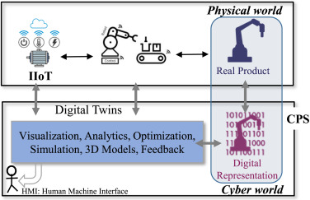
Digital Twin
Industrial DT is a digital tool that recreates an intelligent virtual image of the machines in the edge or cloud based on the incoming IIoT data from field devices, associated with real-time physical attributes of a CPS.
Fig. 1. Illustration of IIoT, CPS and DT for real-world physical assets
(e.g., sensors, machines, robots) and their digital representation,
the simulated cyber space.
Source: https://www.sciencedirect.com/science/article/pii/S1084804521002988
Notes:
It’s about having a didgital twin representation of the different iiot devicess to make informed descions .

Slide 6
Difficulties of DT modeling in IIoT
DT modeling in IIoT still faces some difficulties:
DTs need to be driven by massive data distributed across IIoT devices, but given privacy, competition, and security issues, integrating data scattered across various devices is nearly impossible. (Heterogeneous data)
The real-time interaction between the DTs and the entity object requires frequent communications among the devices.
Notes:
complex network environment

Slide 7
Challenges and Proposed Solutions
Challenge | Proposed solution
Building Digital twins while minimizing privacy leakage and the transmission burden. | Optimized federated learning (FL) .
Heterogeneity of IIoT devices | They selected devices with high utility values to participate in FD; using deep reinforcement learning (DRL) and a clustering scheme.

Slide 8
System Model And Problem Formulation

Slide 9
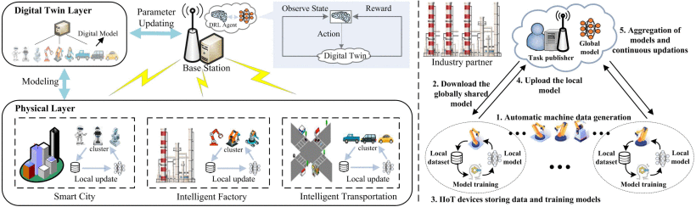
System Model
Fig. 1.Federated learning for digital twin empowered IIoT.

Slide 10
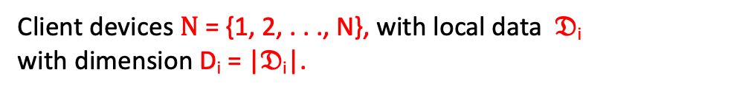
System Model
Client devices $Ν$ = {1, 2, . . ., N}, with local data $𝔇$_{i}
with dimension D_{i} = |$𝔇$_{i}|.
Fig. 1.Federated learning for digital twin empowered IIoT.

Slide 11
System Model
$Β$ = {1, 2, . . ., B}.
Client devices N = {1, 2, . . ., N}, with local data D_{i} with dimension D_{i} = |D_{i}|.
Fig. 1.Federated learning for digital twin empowered IIoT.

Slide 12
System Model
Federated learning
$Β$ = {1, 2, . . ., B}.
Client devices N = {1, 2, . . ., N}, with local data D_{i} with dimension D_{i} = |D_{i}|.
Fig. 1.Federated learning for digital twin empowered IIoT.

Slide 13
Digital twin
In time slot t, the DTs of device i and BS b are denoted by :
DT_{i}(t) = {M_{i}(t), f_{i}(t), P_{i}(t), D_{i}(t)}
and
DT_{b}(t) = {M_{b}(t), f_{b}(t), P_{b}(t), D_{b}(t)}
Where :
- M_{i}(t) and M_{b}(t) refer to the current training statuses of device i and BS b.
f_{i}(t) and f_{b}(t) denote the current computing capabilities of device i and BS b.
P_{i}(t) and P_{b}(t) stand for communication resources of device i and BS b
D_{i}(t) and D_{b}(t) represent the data of device i and BS b.

Slide 14
Data Utility Model

Slide 15
Data Utility Model
In order to select the efficient devices to participate in federated learning , they first evaluate the utility of their data.
When performing FL tasks, the higher utility of the device’s training data can result in the higher accuracy of the local model and the better prediction performance of the aggregated global model.

Slide 16
Data Utility Model
They defined a metric called “prediction accuracy” to quantify the contribution and utility of the device’s data in the task completion( local model).
Considering the unique characteristics of IIoT device data in FL, they focused on three crucial factors of device data:
The data quality.
The data size.
The data distribution.

Slide 17
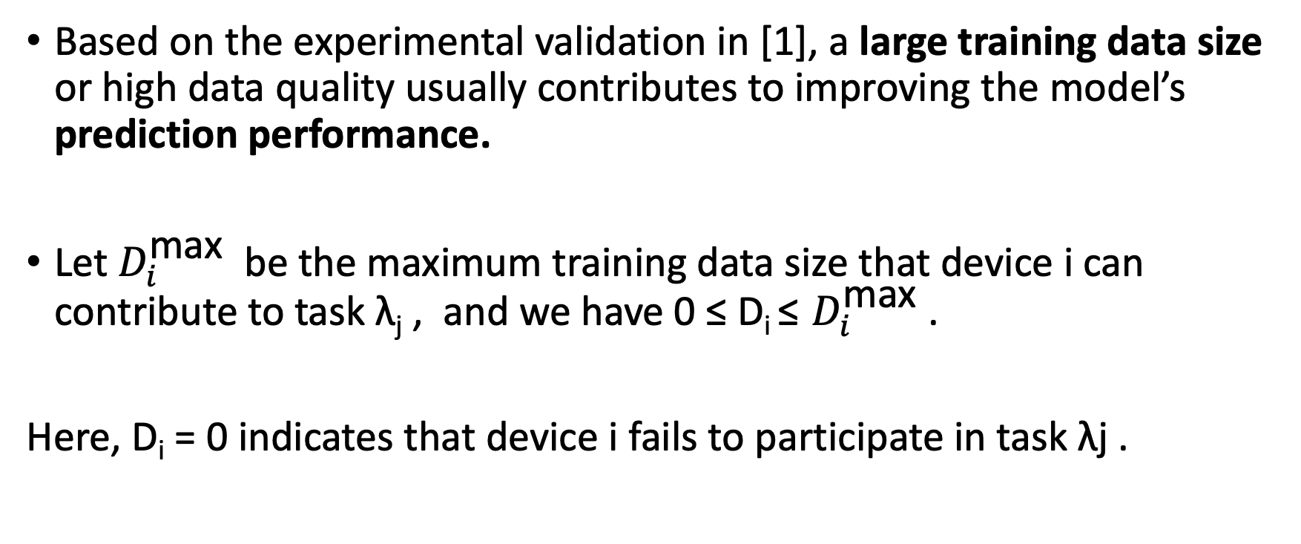
Data size
Based on the experimental validation in [1], a large training data size or high data quality usually contributes to improving the model’s prediction performance.
Let $D_{i}^{\text{max}}$ be the maximum training data size that device i can contribute to task λ_{j} , and we have 0 ≤ D_{i} ≤ $D_{i}^{\text{max}}$ .
Here, D_{i} = 0 indicates that device i fails to participate in task λj .

Slide 18
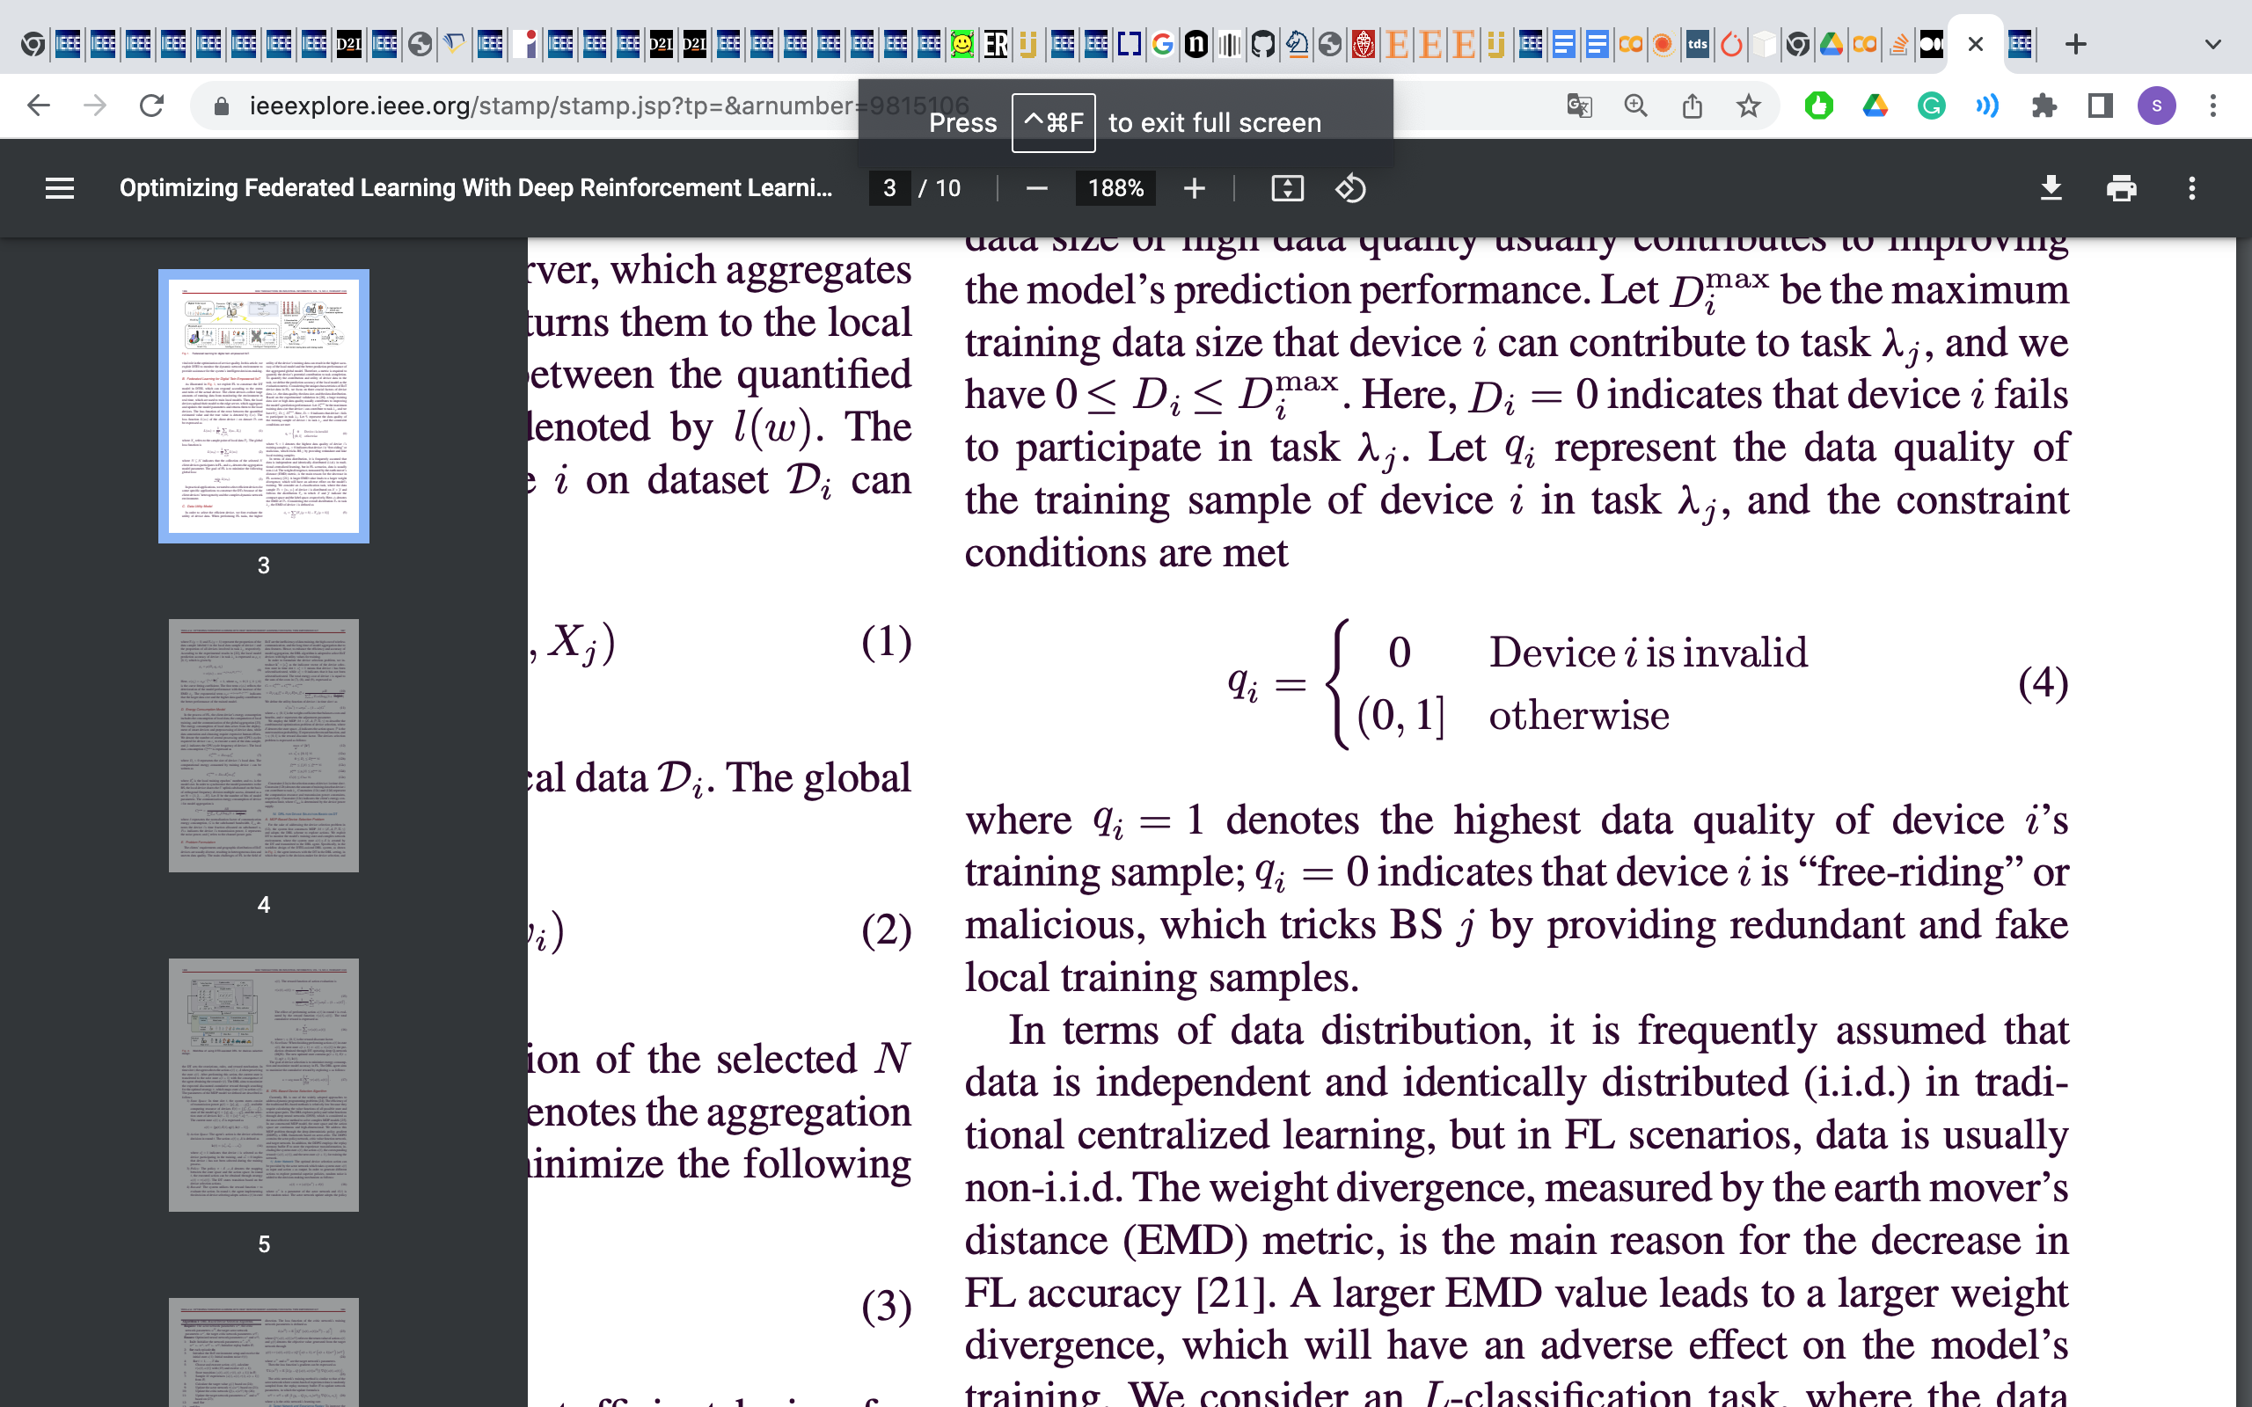
Quality
Let q_{i} represent the data quality of the training sample of device i in task λ_{j} .
Where q_{i} = 1 denotes the highest data quality of device i’s training sample.
q_{i} = 0 indicates that device i is “free-riding” or malicious, which tricks BSj by providing redundant and fake local training samples
Notes:
In the refrence [1] which involves detecting and deleting incomplete and outlier data samples.

Slide 19
Distrebution
In traditional centralized learning , it is frequently assumed that data is independent and identically distributed (i.i.d.), but in FL scenarios, data is usually non-i.i.d.
The weight divergence, measured by the earth mover’s distance (EMD) metric, is the main reason for the decrease in FL accuracy .
A larger EMD value leads to a larger weight divergence, which will have an adverse effect on the model’s training

Slide 20
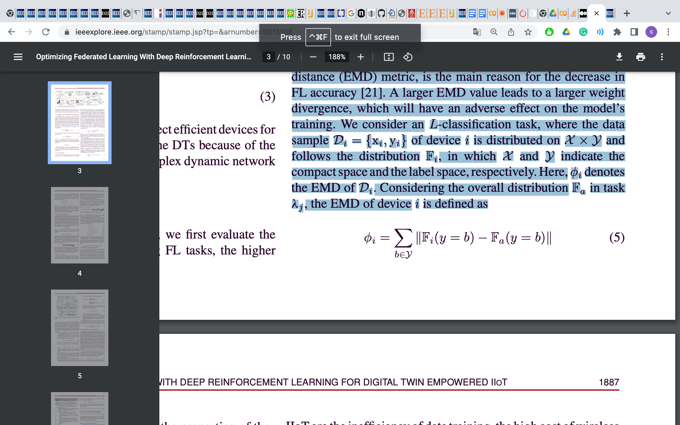
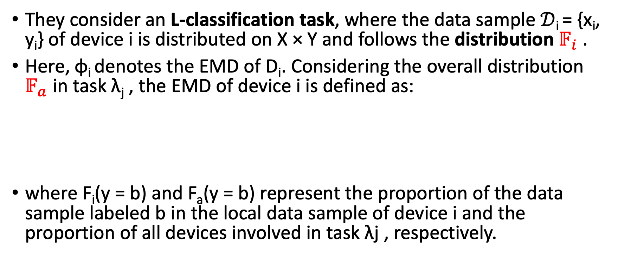
Distrebution
They consider an L-classification task, where the data sample $𝒟$_{i} = {x_{i}, y_{i}} of device i is distributed on X × Y and follows the distribution $𝔽_{i}$ .
Here, φ_{i} denotes the EMD of D_{i}. Considering the overall distribution $𝔽_{a}$ in task λ_{j} , the EMD of device i is defined as:
where F_{i}(y = b) and F_{a}(y = b) represent the proportion of the data sample labeled b in the local data sample of device i and the proportion of all devices involved in task λj , respectively.

Slide 21
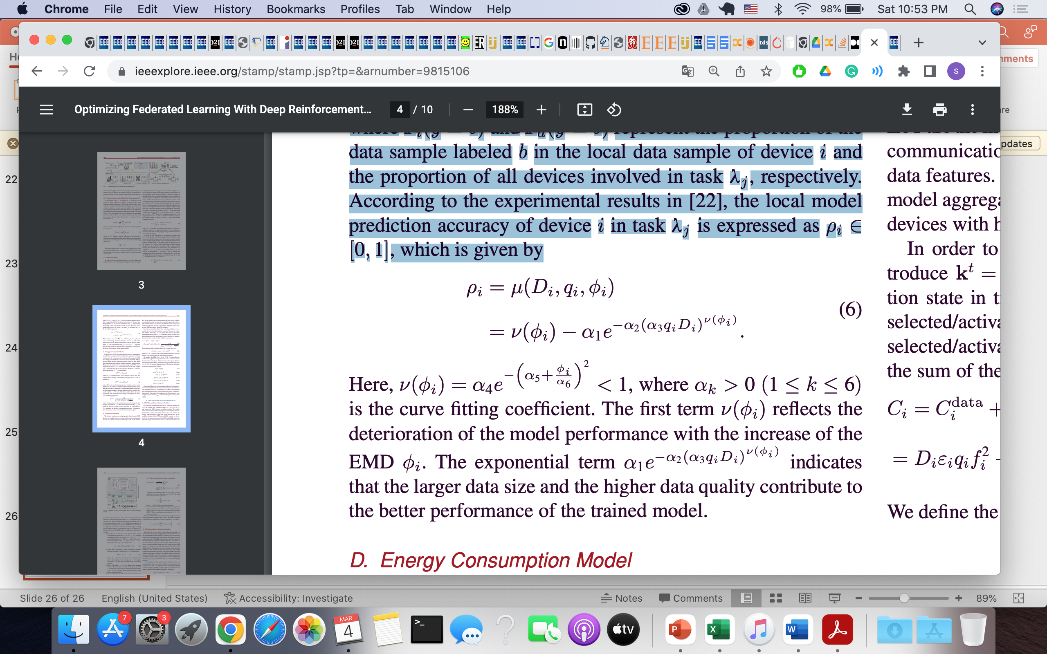
Data Utility Model
According to the experimental results in [2], the local model prediction accuracy of device i in task λj is expressed as ρ_{i} ∈ [0, 1], which is given by
ν(ϕi) reflects the decline of the model performance with the increase of the EMD ϕi.
Notes:
Here, ν(ϕi)=α4e^{−(α5+ϕiα6)2}<1, where α_{k}>0 (1≤k≤6) is the curve fitting coefficient.

Slide 22
Data Utility Model
According to the experimental results in [22], the local model prediction accuracy of device i in task λj is expressed as ρ_{i} ∈ [0, 1], which is given by
The exponential term α₁e^{−α}₂^{(α3qiDi)ν(ϕi)} indicates that the larger data size and the higher data quality contribute to the better performance of the trained model.
Notes:
is the curve fitting coefficient
Look for lj

Slide 23
Energy Consumption Model

Slide 24
Energy Consumption Model
In the process of FL, the client device’s energy consumption includes the following :
1- Consumption of local data.
2- The computation of local training.
3- The communication of the global aggregation.

Slide 25
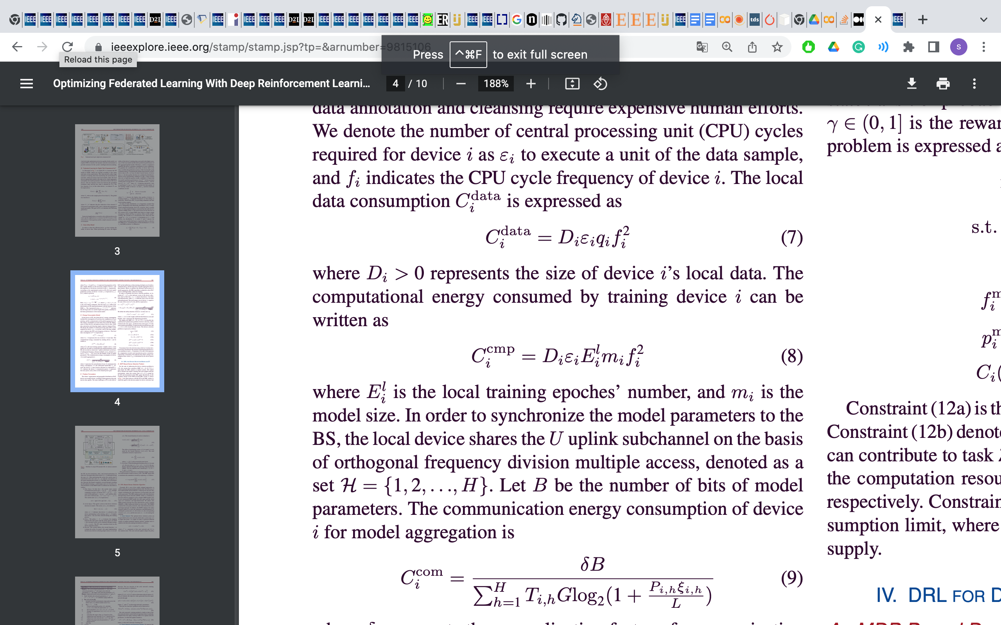
Energy Consumption Model
Local data computation :
ε_{i} is the number of central processing unit (CPU) cycles required for device i as to execute a unit of the data sample.
f_{i} indicates the CPU cycle frequency of device i.

Slide 26
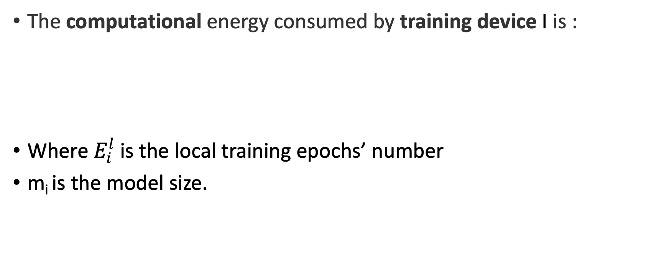
Energy Consumption Model
The computational energy consumed by training device I is :
Where $E_{i}^{l}$is the local training epochs’ number
m_{i} is the model size.

Slide 27
Energy Consumption Model
In order to synchronize the model parameters to the BS, the local device shares the U uplink subchannel on the basis of orthogonal frequency division multiple access (OFDMA), denoted as a set H = {1, 2, . . ., H}.

Slide 28
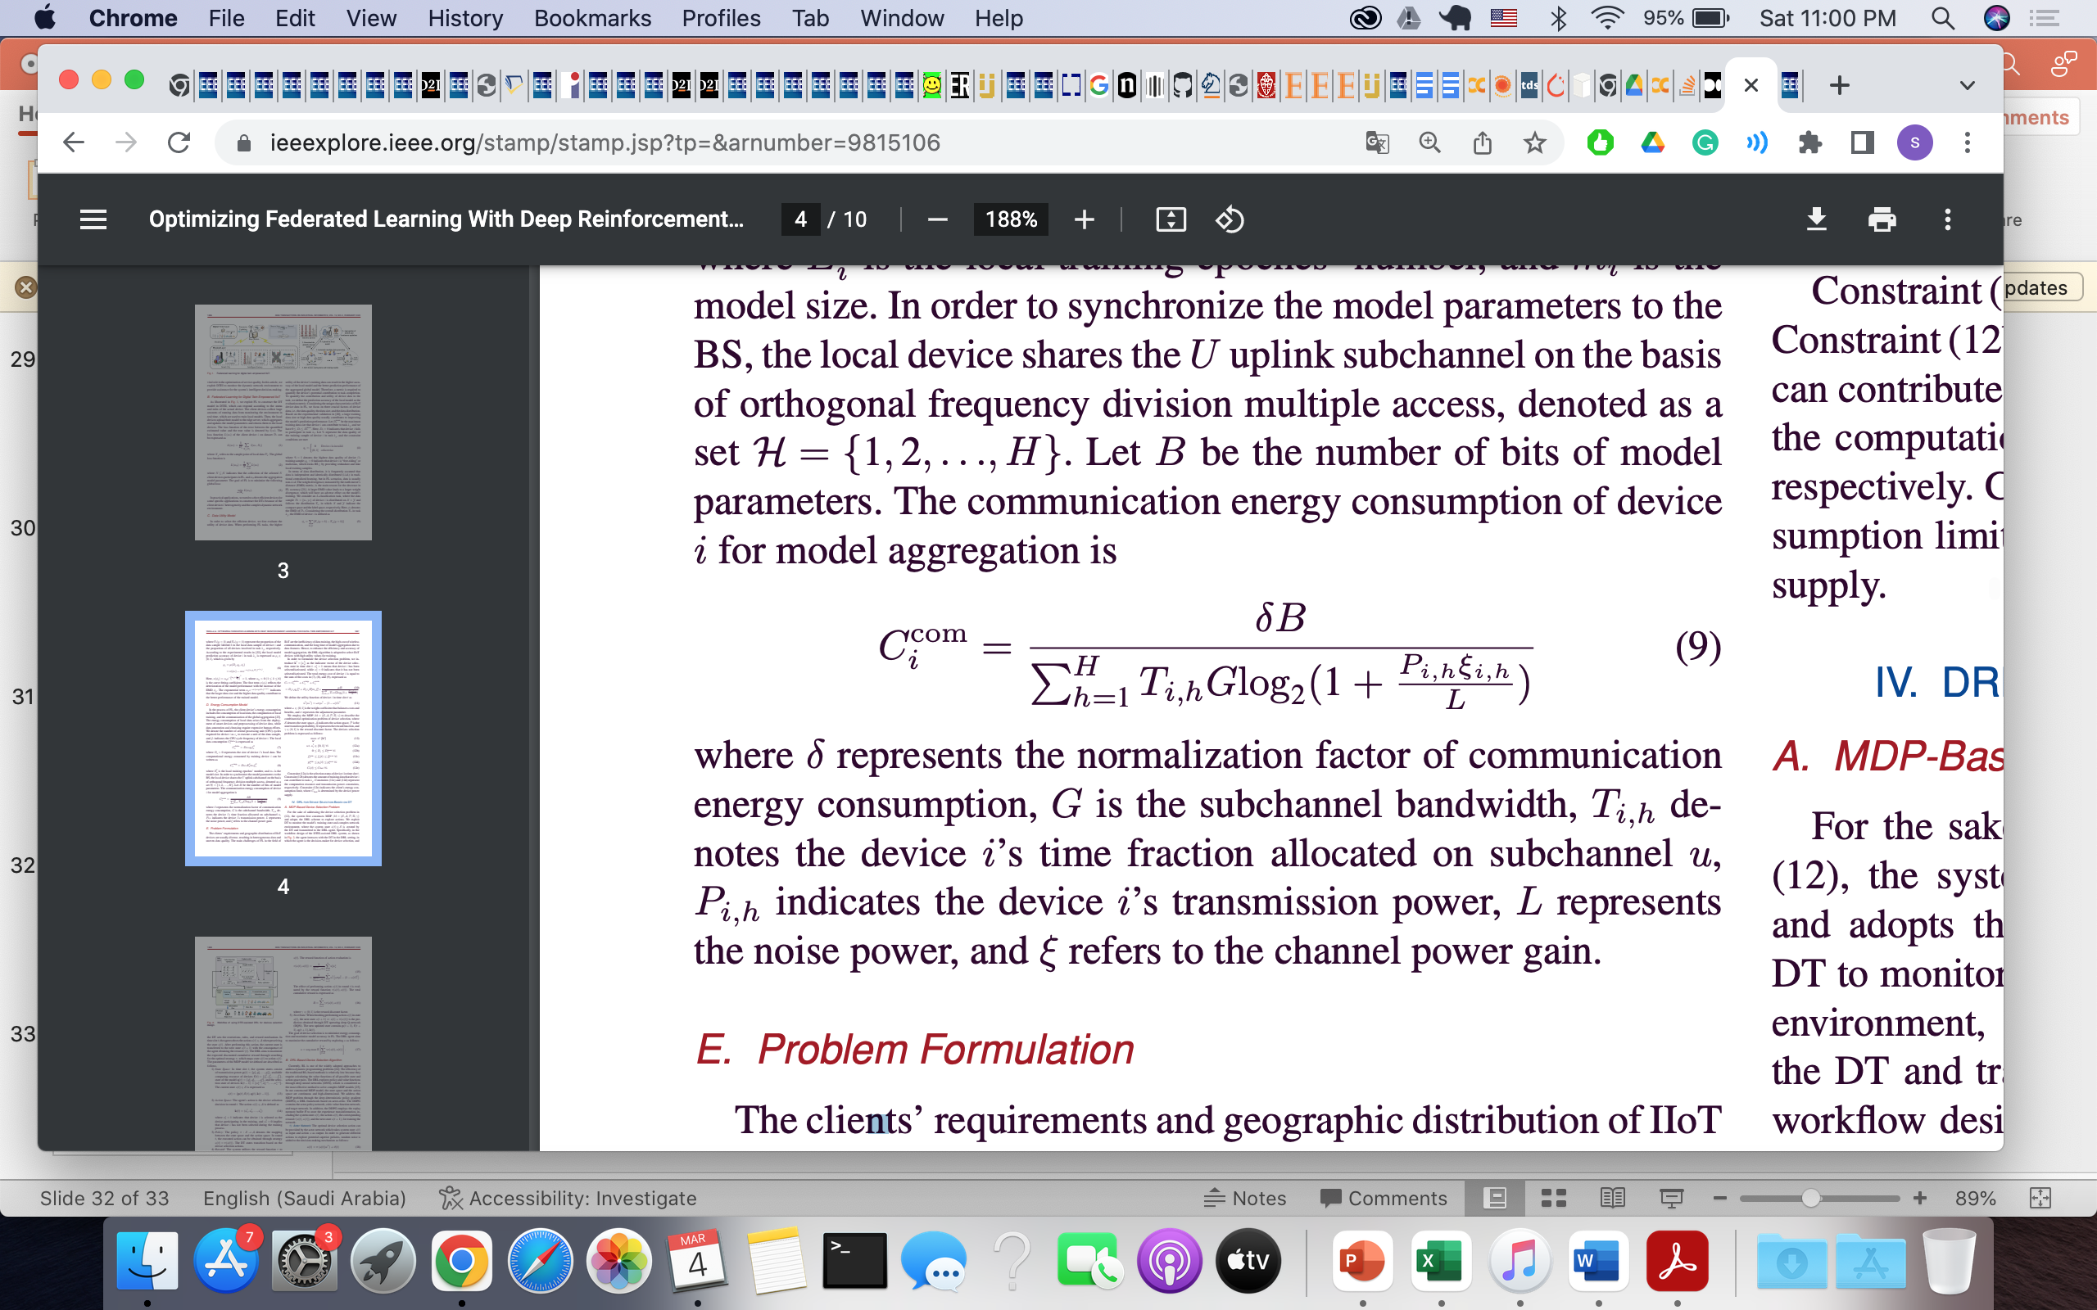
Energy Consumption Model
Let B be the number of bits of model parameters. The communication energy consumption of device i for model aggregation is:
δ represents the normalization factor of communication energy consumption
G is the subchannel bandwidth
T_{i,h} denotes the device i’s time fraction allocated on subchannel u
P_{i,h} indicates the device i’s transmission power
L represents the noise power
ξ refers to the channel power gain

Slide 29
Optimization Problem Formulation

Slide 30
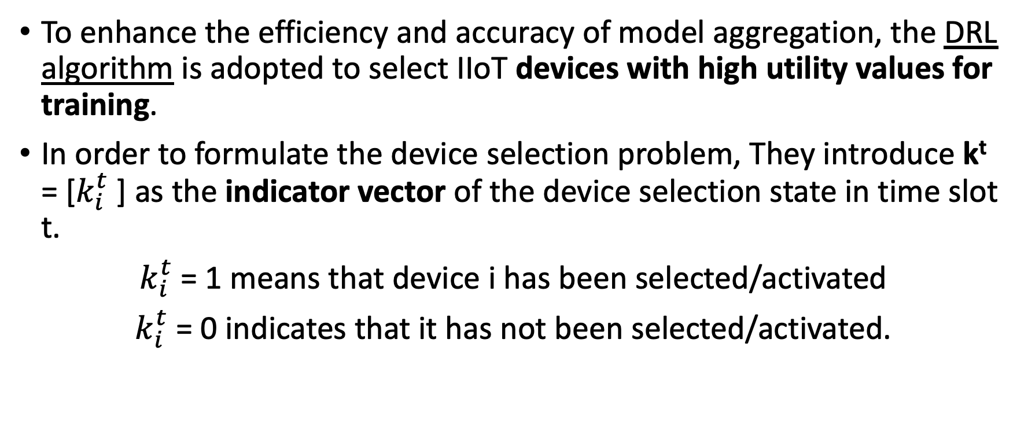
Problem Formulation ( Device Selection )
To enhance the efficiency and accuracy of model aggregation, the DRL algorithm is adopted to select IIoT devices with high utility values for training.
In order to formulate the device selection problem, They introduce k^{t} = [$k_{i}^{t}$] as the indicator vector of the device selection state in time slot t.
$k_{i}^{t}$= 1 means that device i has been selected/activated
$k_{i}^{t}$= 0 indicates that it has not been selected/activated.

Slide 31
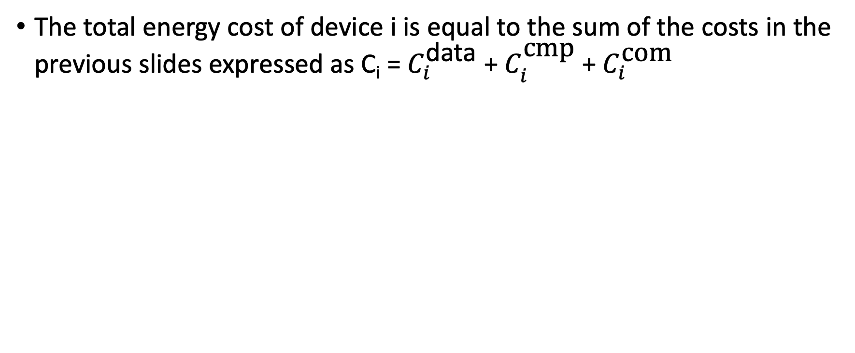
Problem Formulation (Total Energy Cost )
The total energy cost of device i is equal to the sum of the costs in the previous slides expressed as C_{i} = $C_{i}^{\text{data}}$ + $C_{i}^{\text{cmp}}$ + $C_{i}^{\text{com}}$

Slide 32
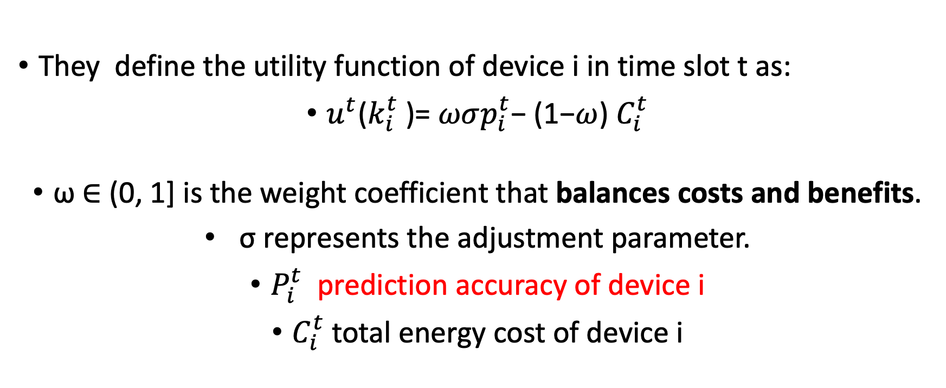
Problem Formulation(Utility Function )
They define the utility function of device i in time slot t as:
$u^{t}$($k_{i}^{t}$)= $ωσp_{i}^{t}$− (1−$ω$) $C_{i}^{t}$
ω ∈ (0, 1] is the weight coefficient that balances costs and benefits.
σ represents the adjustment parameter.
$P_{i}^{t}$ prediction accuracy of device i
$C_{i}^{t}$total energy cost of device i
Notes:
Segma

Slide 33
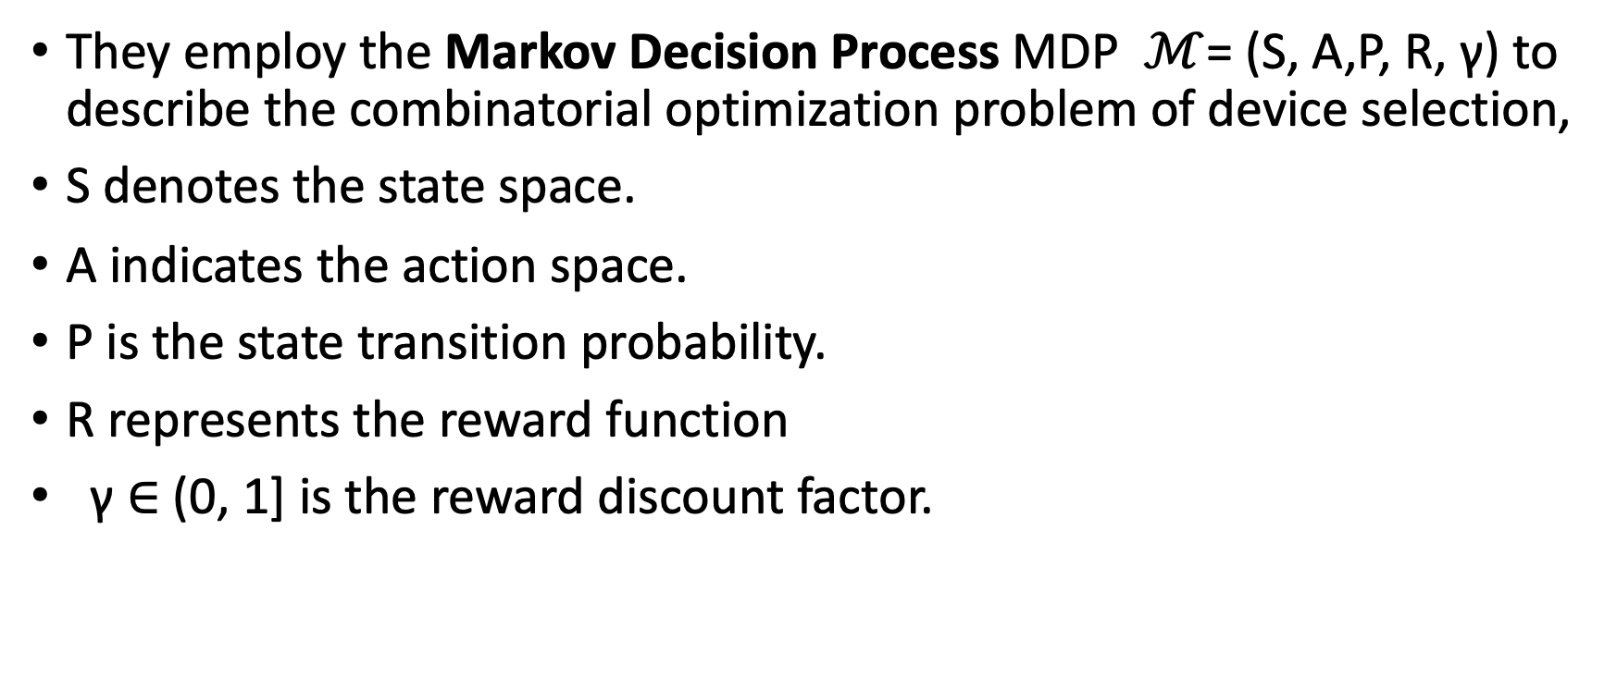
Problem Formulation
They employ the Markov Decision Process MDP $ℳ$= (S, A,P, R, γ) to describe the combinatorial optimization problem of device selection,
S denotes the state space.
A indicates the action space.
P is the state transition probability.
R represents the reward function
γ ∈ (0, 1] is the reward discount factor.

Slide 34
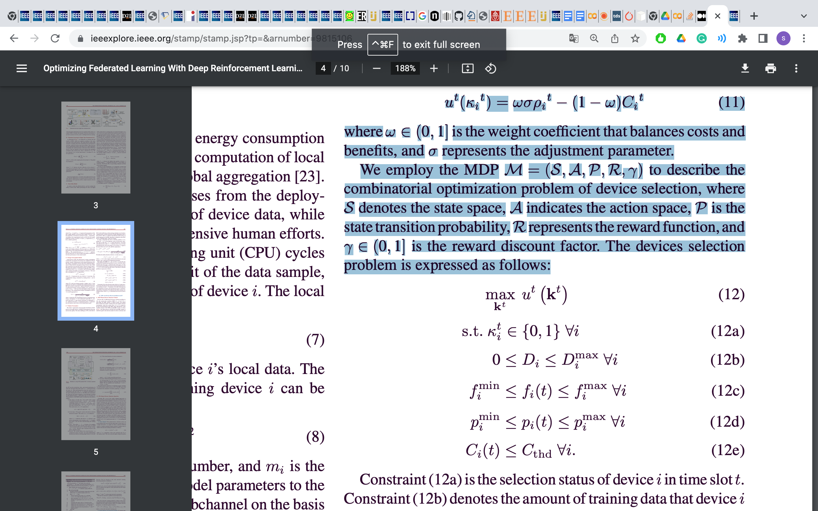
Problem Formulation
The devices selection problem is expressed as follows:
Notes:
Cthd is determined by the device power
supply.

Slide 35
Problem Formulation
The devices selection problem is expressed as follows:
The selection status of device I in time slot t.

Slide 36
Problem Formulation
The devices selection problem is expressed as follows:
Denotes to the amount of training data that device i can contribute to task λj

Slide 37
Problem Formulation
The devices selection problem is expressed as follows:
Represent the computation resource
transmission power constraints

Slide 38
Problem Formulation
The devices selection problem is expressed as follows:
indicates the client’s energy consumption limit
Notes:
Cthd is determined by the device power
supply.

Slide 39
DRL for Device Selection Based on DT
The DRL aims to maximize the expected discounted cumulative reward through searching for the optimal strategy π, which maps state s(t) to action κ(t).

Slide 40
DRL for Device Selection Based on DT
State Space:
In time slot t, the system states consist of transmission power p(t), available computing resource of devices f(t) , state of the model q(t) , and the selection state of devices k(t−1) .
The current state s(t)∈S is expressed as:
s(t)={p(t),f(t),q(t),k(t−1)}.

Slide 41
DRL for Device Selection Based on DT
State Space:
They exploit DT to monitor the model’s training state and complex network environment, where the system state s(t) ∈ S is created by the DT and transmitted to the DRL agent.
The agent interacts with the DT in the DRL setting, in which:
The Agent > The decision-maker for device selection.
The DT > sets the restrictions, rules, and reward mechanism.

Slide 42
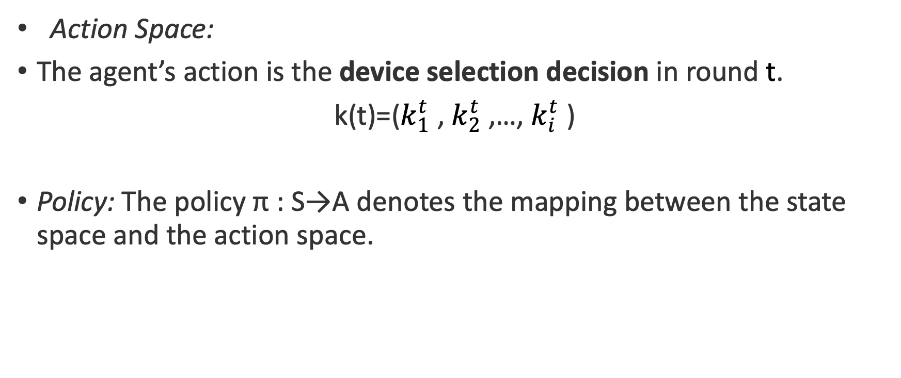
DRL for Device Selection Based on DT
Action Space:
The agent’s action is the device selection decision in round t.
k(t)=($k_{1}^{t}$, $k_{2}^{t}$,…, $k_{i}^{t}$)
Policy: The policy π : S→A denotes the mapping between the state space and the action space.

Slide 43
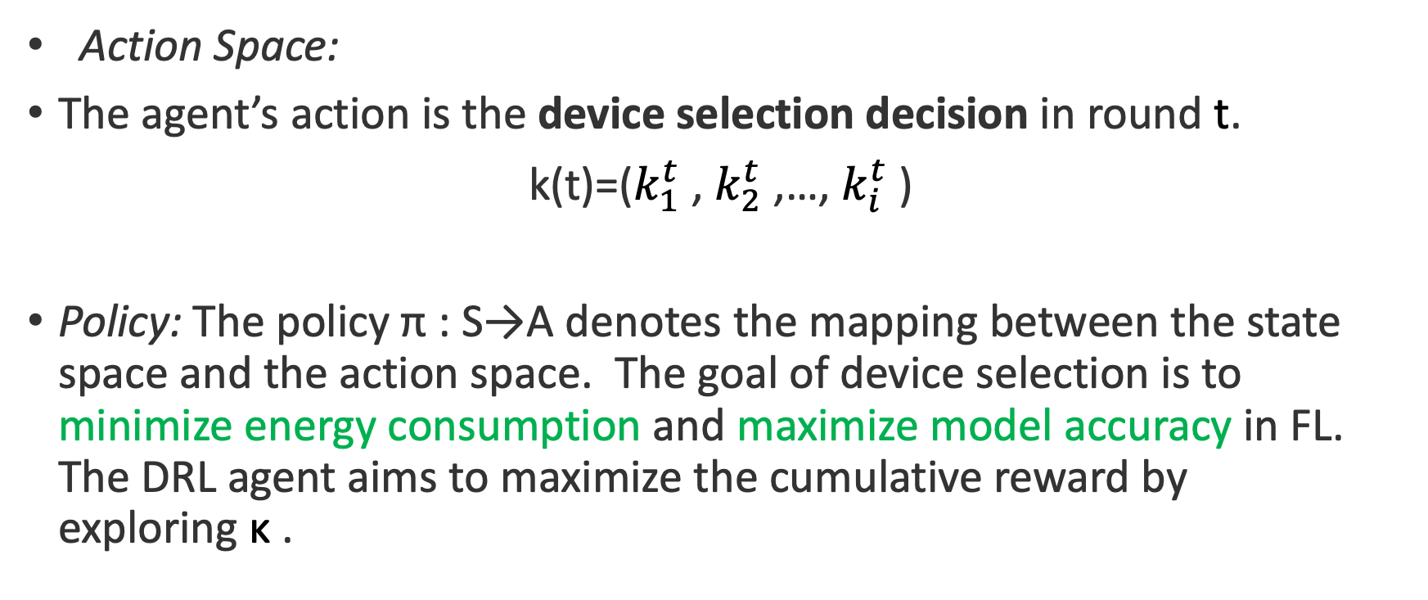
DRL for Device Selection Based on DT
Action Space:
The agent’s action is the device selection decision in round t.
k(t)=($k_{1}^{t}$, $k_{2}^{t}$,…, $k_{i}^{t}$)
Policy: The policy π : S→A denotes the mapping between the state space and the action space. The goal of device selection is to minimize energy consumption and maximize model accuracy in FL. The DRL agent aims to maximize the cumulative reward by exploring κ .
Notes:
deep detedeep Q-network
(DQN)
they address this
MDP problem through the deep deterministic policy gradient
(DDPG)

Slide 44
DRL-Based Asynchronous Federated Learning

Slide 45
Asynchronous Federated Learning
The main idea is :
1- To select the optimally participating devices (previous slides )
2-Classify the devices with different utility values by cluster.
3- Configure the corresponding aggregator for each cluster to realize asynchronous learning.
In this case, each cluster can be trained at different local aggregation frequencies.

Slide 46
DRL-Based Asynchronous Federated Learning
The proposed asynchronous FL framework mainly includes the following four steps:
Device selection.
Device clustering.
Local training.
Global aggregation.

Slide 47
DRL-Based Asynchronous Federated Learning
They proposed asynchronous FL framework mainly includes the following four steps:
Device selection.
a device with higher utility is selected to participate in FL within the given communication time. The server selects the optimal subset of devices N_{i}∈N through the DRL-based algorithm.

Slide 48
DRL-Based Asynchronous Federated Learning
They proposed asynchronous FL framework mainly includes the following four steps:
Device clustering.
They classify devices based on the data size and computing power by clustering algorithm K-means and then assigning corresponding aggregators to constitute the local training cluster. Hence, in the identical cluster of the local model, the training time of the device is similar which eliminates the straggler effect.

Slide 49
DRL-Based Asynchronous Federated Learning
They proposed asynchronous FL framework mainly includes the following four steps:
3. Local Training
In round t, the model w_{i}(t) is trained by the local device i on its data D_{i} through calculating the local gradient . Then, device i transmits the updated local parameter w_{i}(t) to the corresponding aggregators for aggregation.

Slide 50
DRL-Based Asynchronous Federated Learning
They proposed asynchronous FL framework mainly includes the following four steps:
Global aggregation:
The aggregator obtains the model trained by the local devices and performs global aggregation by aggregating the local model w_{i}(t) into the weighted global model w(t)

Slide 51
Experiment Results

Slide 52
Experiment Settings
They evaluated the performance of the proposed asynchronous FL protocol on the MNIST dataset.
To simulate the IIoT settings, they assumed that there are 100 smart devices in the system and considered a scenario where a single BS is used as an aggregation server. The dataset is divided into 100 pieces, which are allocated to 100 smart devices.

Slide 53
Local Training Model
Training Model : The convolutional neural network model (CNN) , which includes two convolutional layers, two fully connected layers, and an average pooling layer.

Slide 54
Baseline Model
They used the state-of-the-art asynchronous FL schemes as the baselines :
1- Asynchronous federated stochastic gradient descent for vertically partitioned (AFSGD-VP) [3]
2- Communication-efficient for federated averaging (CE-FedAvg) [4]
Note : AFSGD-VP ignores the influence of the inefficient device, while the CE-FedAvg is affected by the straggler effect.

Slide 55
Baseline Model
In addition, they add two common baselines, namely :
3- Centralized training
4- Stand-alone training.

Slide 56
Experiments (EMD)
They set four different EMD values ϕ=0, ϕ=0.2, ϕ=0.4, and ϕ=0.8 for evaluating the data utility function .
Different EMD values can be obtained by varying the number of labels and the data size on the local device.
The larger EMD value results in the higher data similarity, which provides low-quality local model parameters for global aggregation, thereby reducing the global model accuracy.

Slide 57
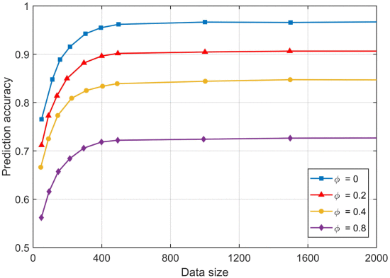
Experiments (Data Utility)
The data utility is measured by the accuracy of the model prediction.
The figure shows that the data utility function can fit the experimental results well.
When ϕ=0 and ϕ=0.8, the training model accuracy is the highest and lowest, respectively.
They refer to low-quality devices as inefficient devices, which have low data utility, poor communication, and computing capabilities, and an adverse effect on global aggregation.
Evaluation of the data utility function.

Slide 58
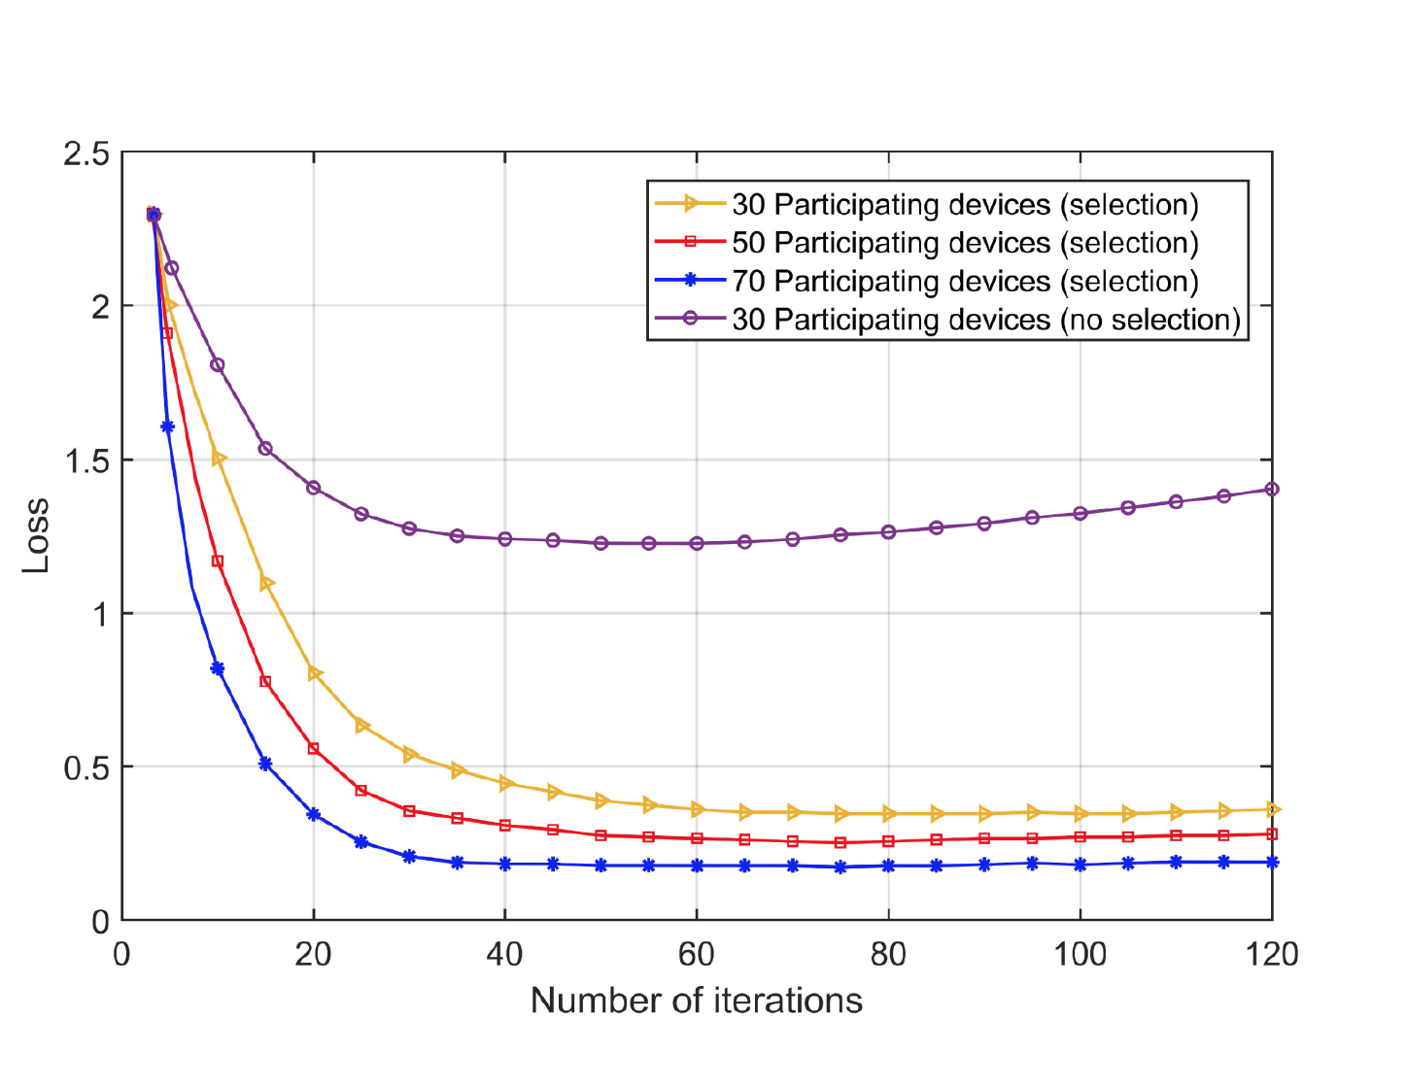
Experiments (Selection scheme’s performance)
They evaluate the proposed scheme’s performance on different numbers of training devices. To verify the developed device selection scheme’s performance,
They established three training device groups, (30, 50, and 70, with 10 inefficient devices in each group.)
Loss of different numbers of training devices.

Slide 59
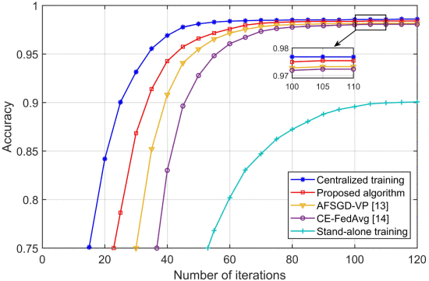
Experiments (comparison with baseline methods)
Their proposed scheme’s performance is close to that of centralized training and better than AFSGD-VP and CE-FedAvg.
In addition, their scheme requires fewer iterations than AFSGD-VP and CE-FedAvg to reach its optimum.
Global accuracy of different benchmark schemes.

Slide 60
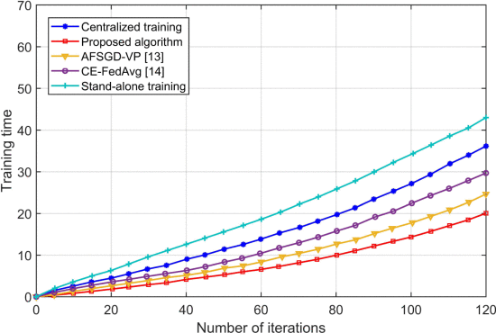
Experiments (comparison with baseline methods)
As seen from the figure, their proposed scheme is superior to other methods in the case of minimal training time.
This is because the device selection and clustering mechanism in their scheme eliminate the straggler effect and effectively avoid inefficient devices, through which the convergence speed and learning quality are improved.
Training time of different benchmark schemes.

Slide 61
Conclusion

Slide 62
Conclusion
They proposed the DTEI architecture which employs DTs in IIoT for real-time perception and intelligent decision-making.
With the objective of improving the model training efficiency and accuracy of the IIoT device, They developed a DRL-assisted FL framework. The DRL is used to select some high-efficiency IIoT devices for aggregation.
Experimental results were presented to show that the proposed scheme performs better than the benchmark scheme in aspects of convergence rate and training accuracy.

Slide 63
Questions ?

Slide 64
Refrences
[1] Y. Jiao, P. Wang, S. Feng and D. Niyato, "Profit maximization mechanism and data management for data analytics services", IEEE Internet Things J., vol. 5, no. 3, pp. 2001-2014, Jun. 2018.
[2] Y. Jiao, D. Wang, B. Lin and D. I. Kim, "Toward an automated auction framework for wireless federated learning services market", IEEE Trans. Mob. Comput., vol. 20, no. 10, pp. 3034-3048, Oct. 2021.
[3]B. Gu, A. Xu, Z. Huo, C. Deng and H. Huang, "Privacy-preserving asynchronous vertical federated learning algorithms for multiparty collaborative learning", IEEE Trans. Neural Netw. Learn. Syst., vol. 32, no. 7, pp. 1-13, Jun. 2021.
[4] J. Mills, J. Hu and G. Min, "Communication-efficient federated learning for wireless edge intelligence in IoT", IEEE Internet Things J., vol. 7, no. 7, pp. 5986-5994, Jul. 2020.

